Slide 1
COMP3000 PROJECT
VARIANCE

Slide 2

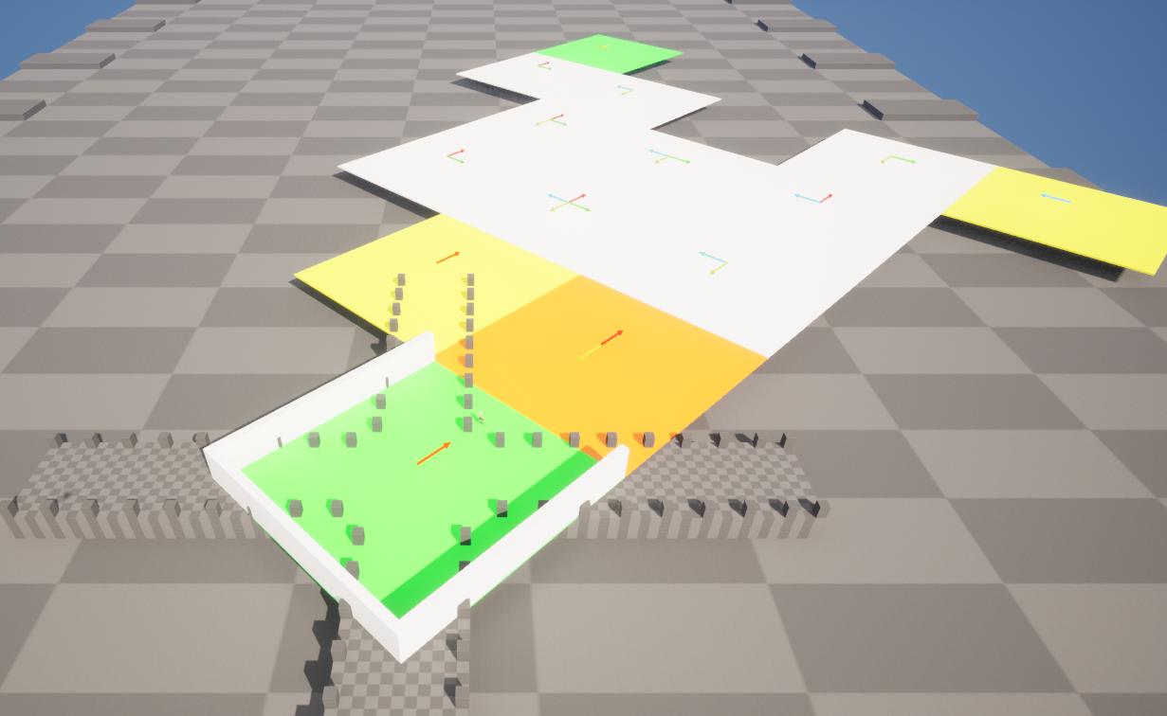
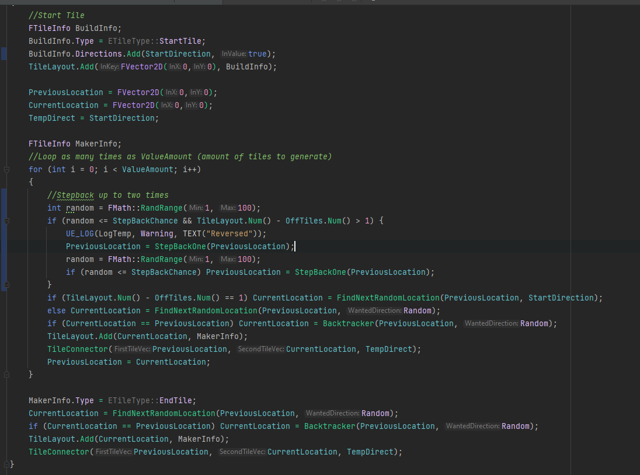
SPRINT 4 RESULTS
Procedural Dungeon Generator mostly completed
Recursive Backtracking algorithm implemented
Fully modular design
Allows for disabling of tiles, forced tiles, 100+ tiles.

Slide 3
Sprint 4 reflection
Missed goals for other systems (enemies, HP, HUD)
Happy with procedural generation of levels so far

Slide 4
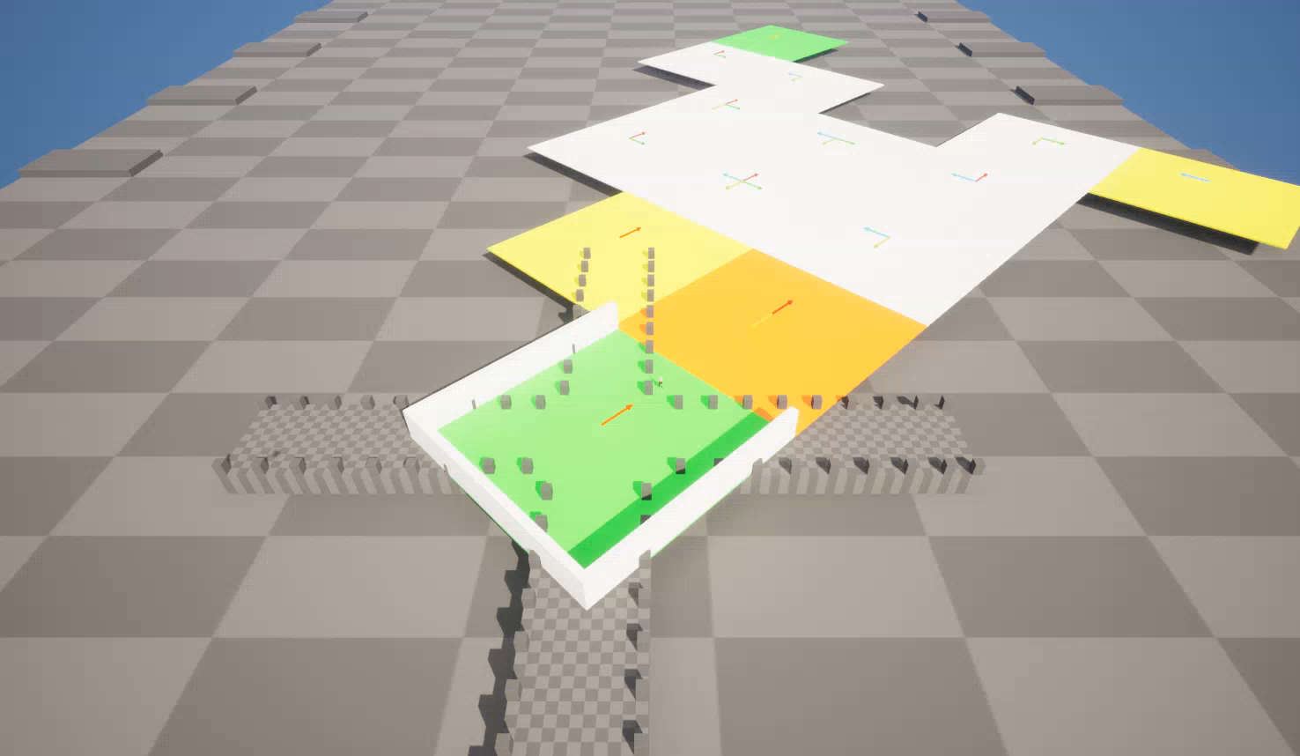

Slide 5
Sprint 5 goals
Basic enemy player (something that will just spawn, and take damage)
Level design concepts, rooms, etc
Simple HUD displaying HP

